Slide 1
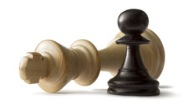
GGP Week 4

Slide 2
Recap
Which heuristics are you using?
How did you implement player mobility?
Did anyone implement opponent mobility/focus with 3+ players?
How do you set depth?
Does anyone use iterative deepening?
How do you compute weights?
Does anyone use the start clock?
Are tournament rules clear?
Notes:
Readings versus video?

